Slide 1
TechJam - Data Integration Strategy
Team: Islington Green

Slide 2
Initial Strategy
MongoDB
Map/POCO Model
VA Customer.txt
Parser
Web Client

Slide 3
Pivot
MongoDB
Map/POCO Model
VA Customer.txt
Parser
Web Client

Slide 4
What we did
MongoDB
VA Customer.txt
Parser
Web Client

Slide 5
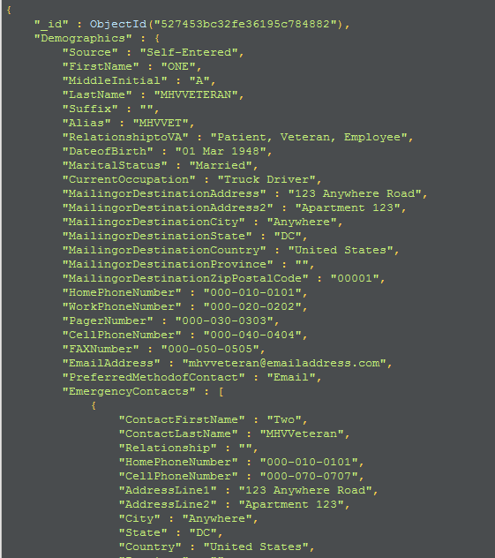

Slide 6
Parser Strategy
Demographics
MongoDB
Appointments
VA Customer.txt
Medical Events
Allergies/Adverse Reactions

